Slide 1
Algorithmic Trading System
Team Black Bird
Syracuse University
CSE687 March 24, 2023

Slide 2
Updates
Microservice 1:
Sign in/Register API
List Strategies API
Stock Symbol API
Save Strategy Metadata API
Save Moving Averages Strategy API
Microservice 2:
Back testing Strategy API
Create User Order by Strategy
Fetch User Orders created by Strategy API

Slide 3
Updates
Frontend
Login
Discover Strategies page
Save Strategy Metadata page
Save Moving Averages strategy data
View Orders executed by back tested strategy

Slide 4
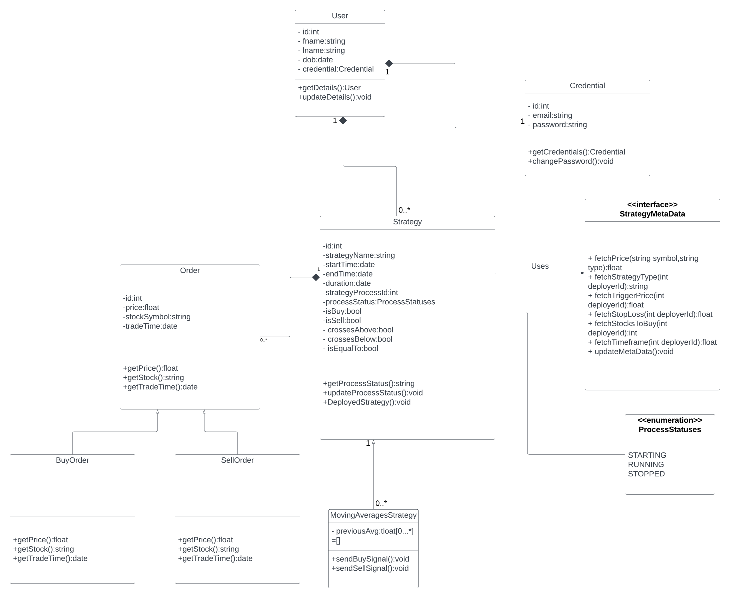
Class Diagram

Slide 5
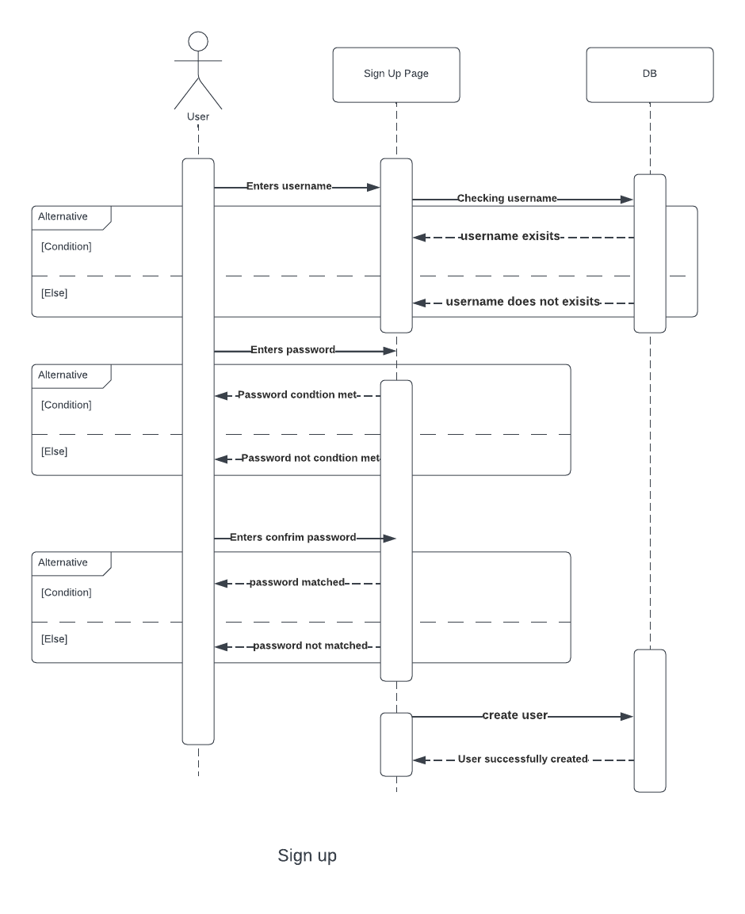
Sequence Diagram
Credentials
Sign Up

Slide 6
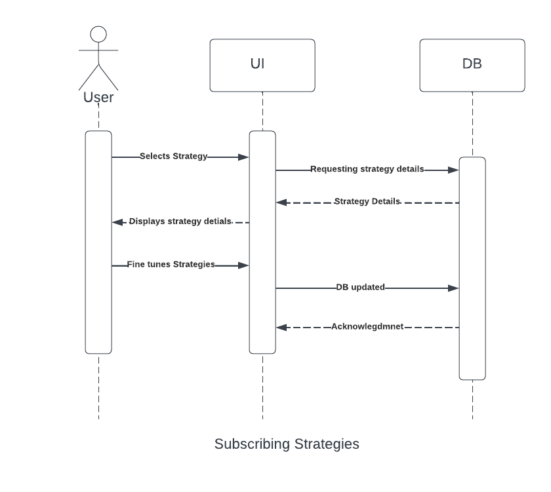
Sequence Diagram
Discover page
Strategy
Select Strategy Page
Subscribing Strategies

Slide 7
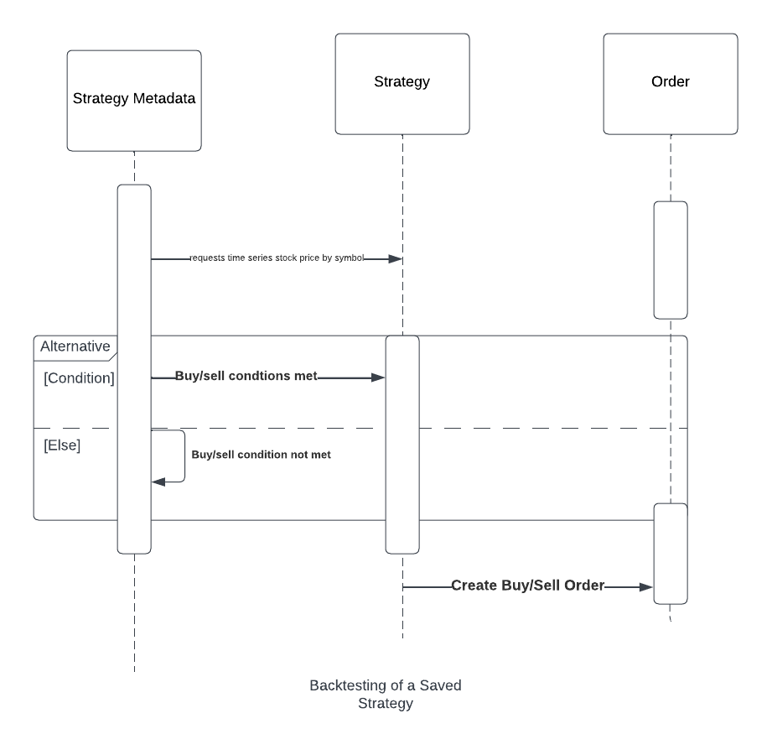
Sequence Diagram
Backtesting of a saved Strategy

Slide 8
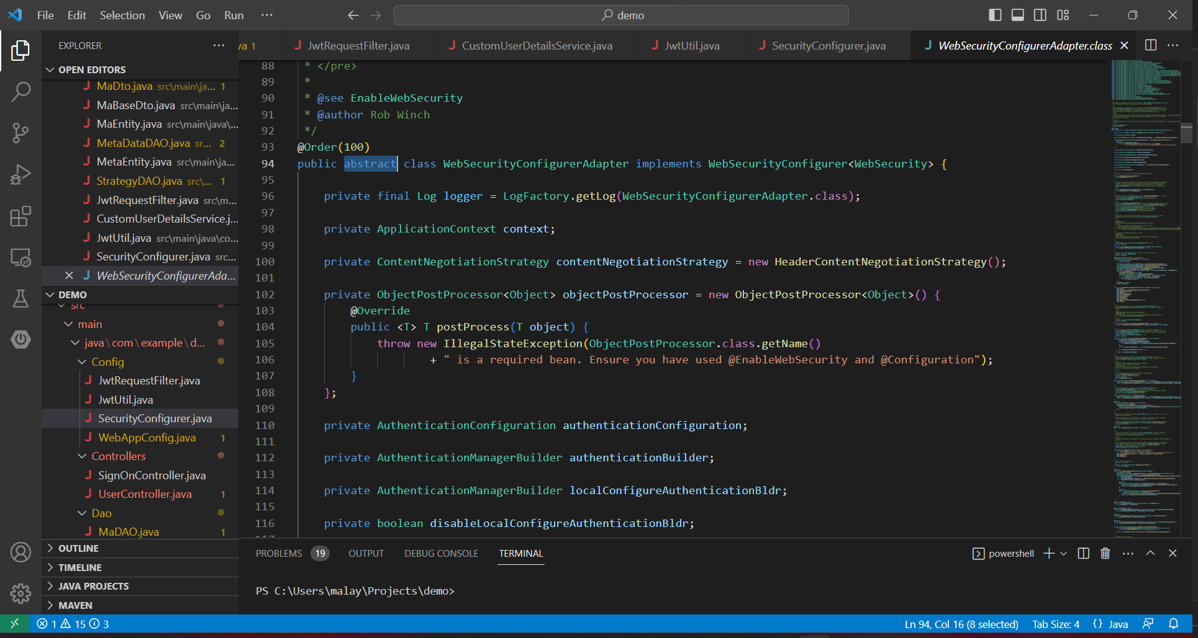
Abstraction

Slide 9
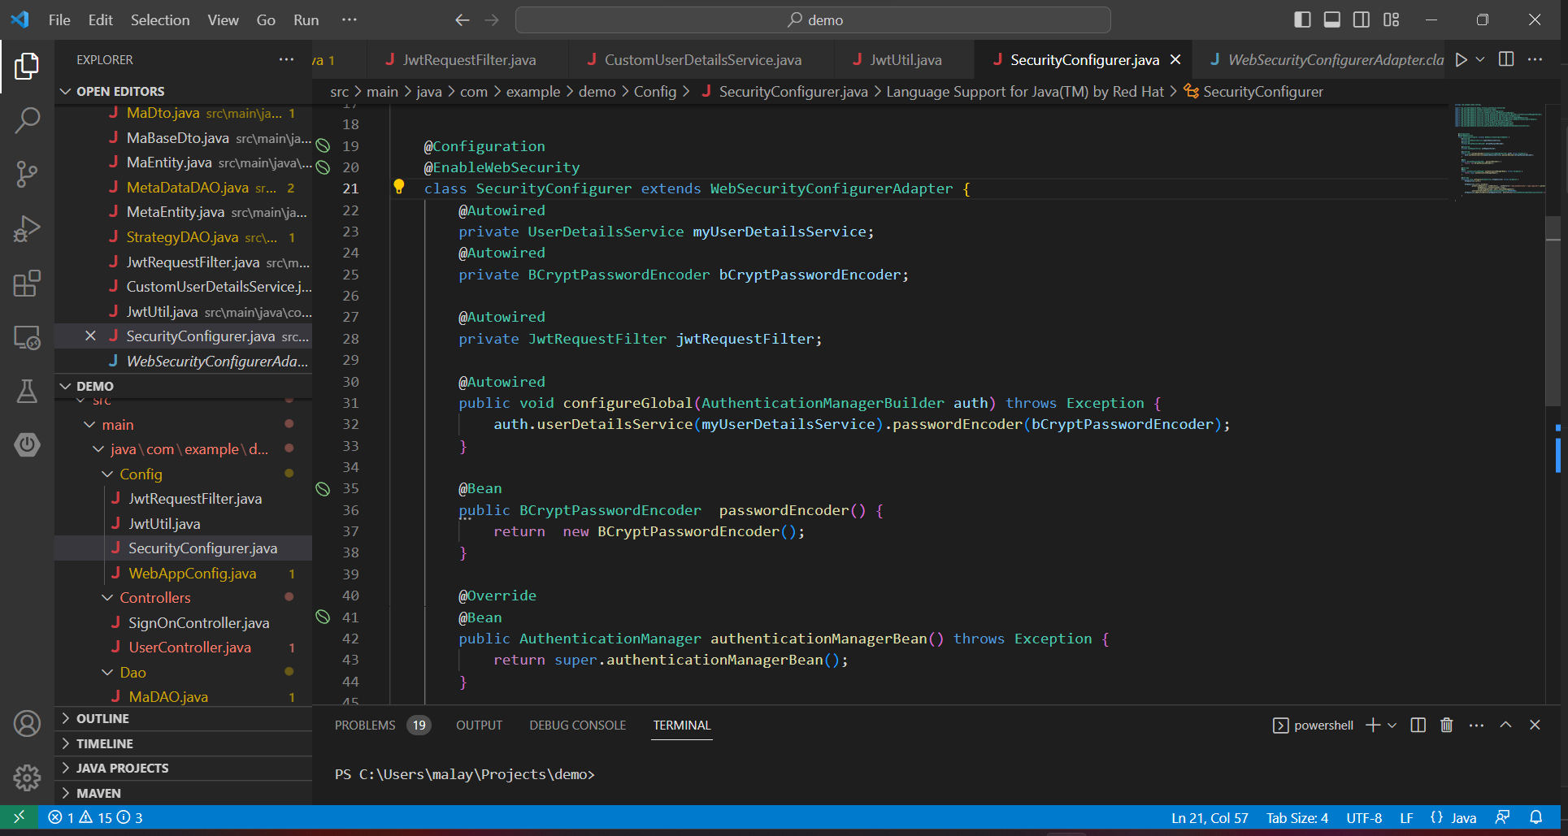
Abstraction Continued

Slide 10
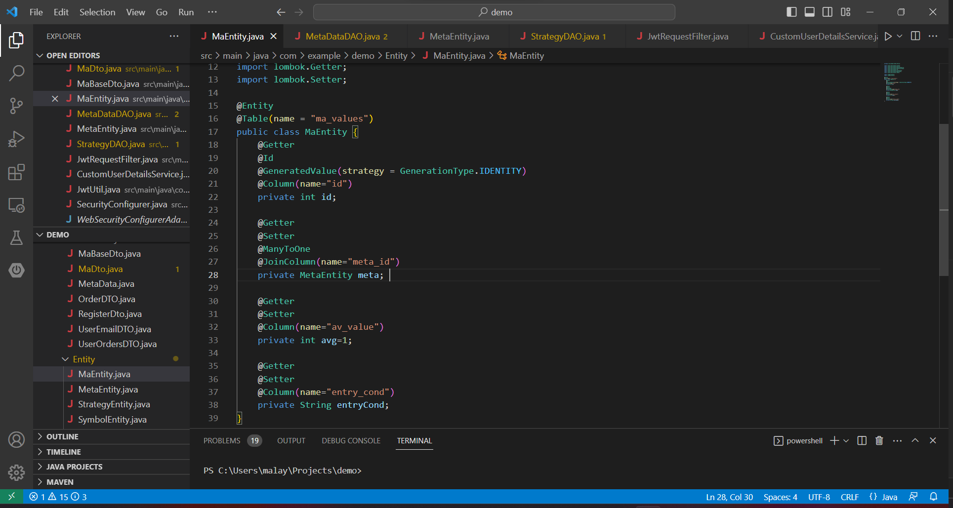
Encapsulation
@Getter and @Setter are annotations which dynamically generates getters and setters at build time.

Slide 11
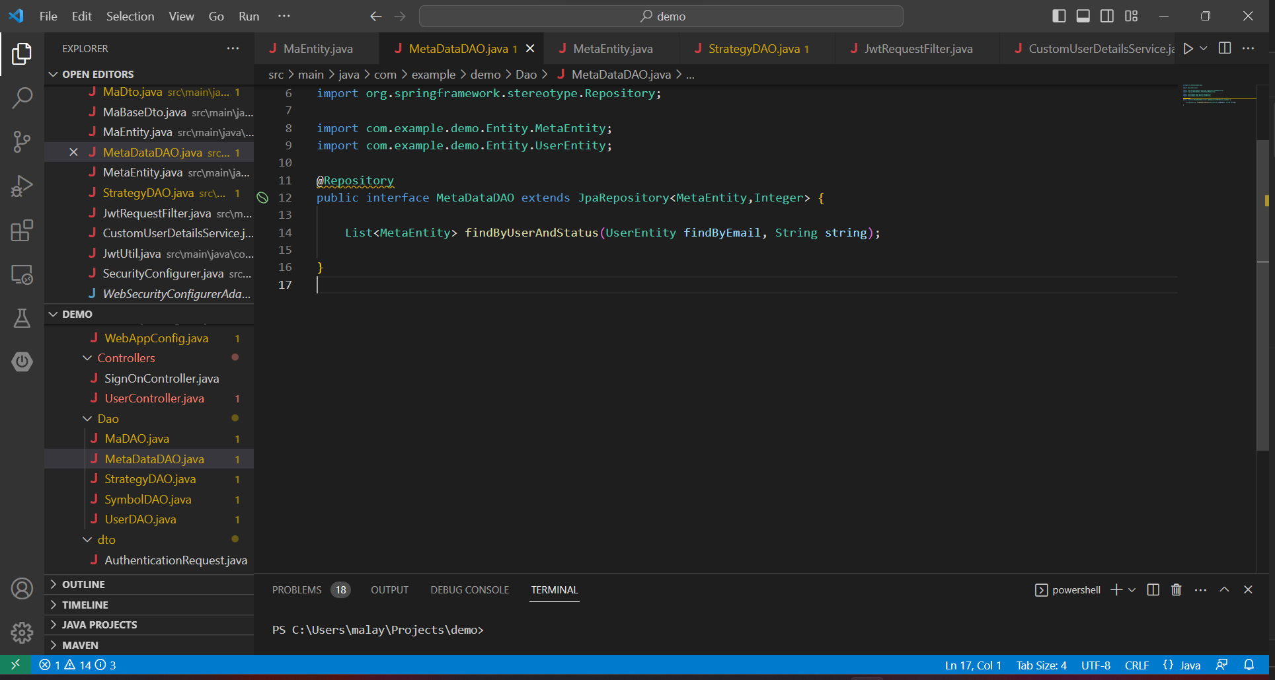
Inheritance

Slide 12
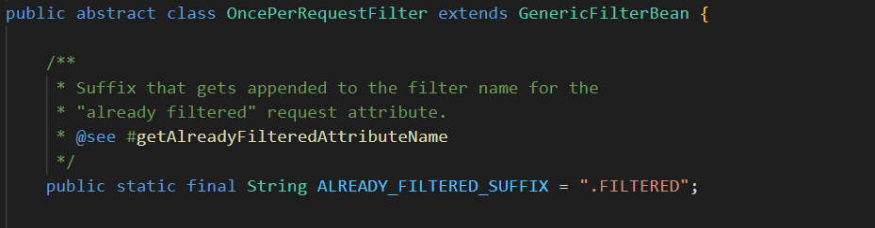
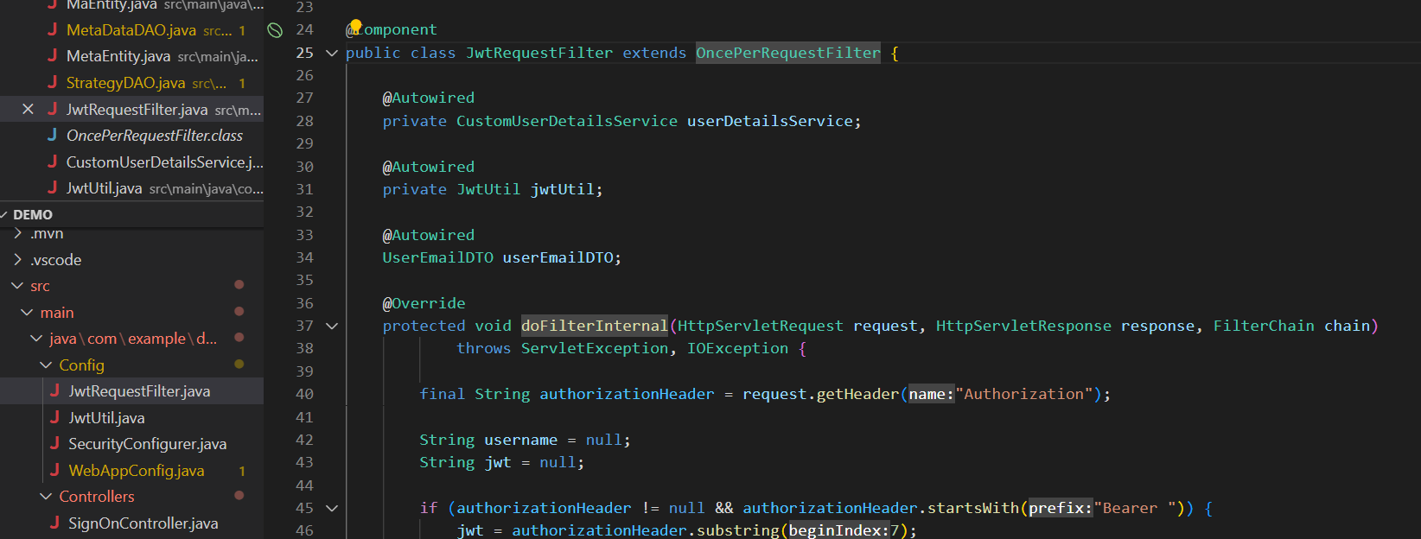
Polymorphism
This abstract class contains an abstract function doFilterInternal which is overridden in the concrete class JwtRequestFilter

Slide 13
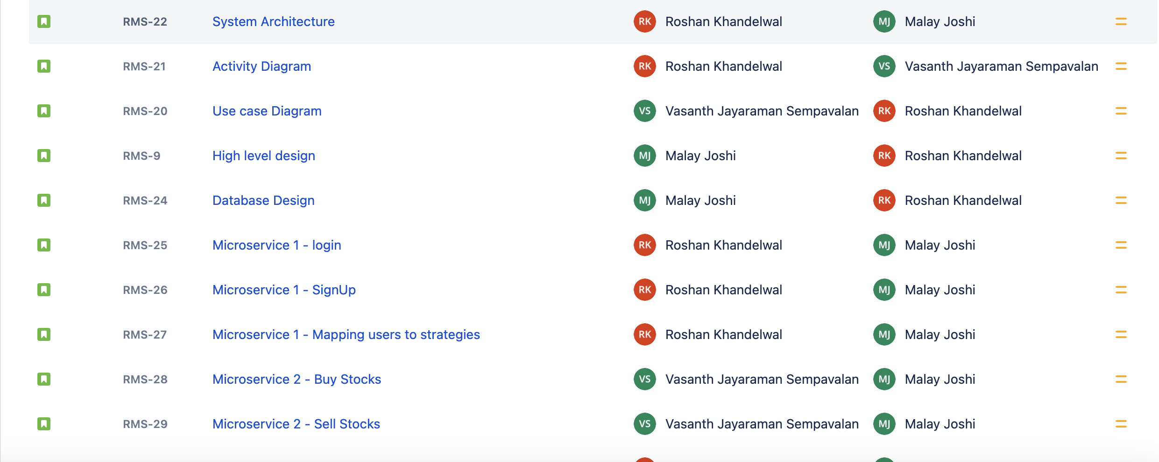
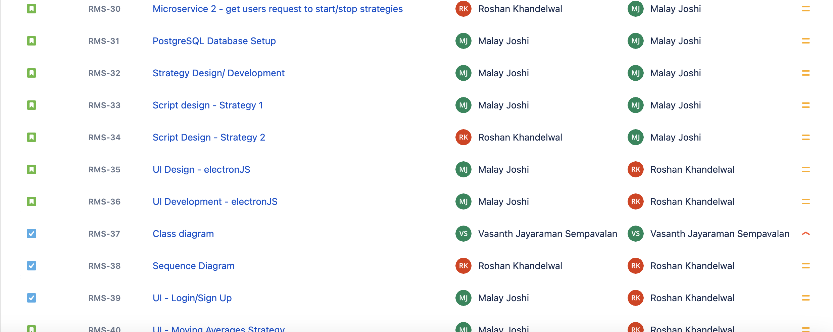
Jira Stories

Slide 14
Thank you!
Team Black Bird
Syracuse University
CSE687 March 24, 2023

